Slide 1
Report of Agile2018
-Subtitle-
Hiroyuki Ito

Slide 2
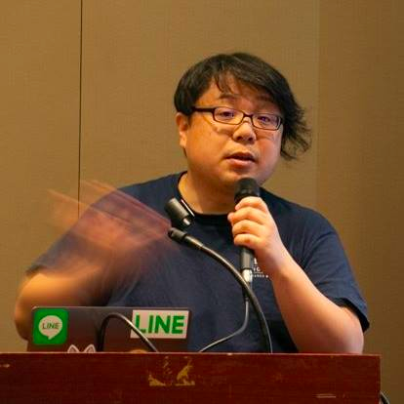


Hiroyuki Ito (The HIRO)
@hageyahhoo
The 1st SET at LINE Corp.
Keynote Speaker of DevOps Summit 2016 (TW)
Speaker of Agile2014

Slide 3
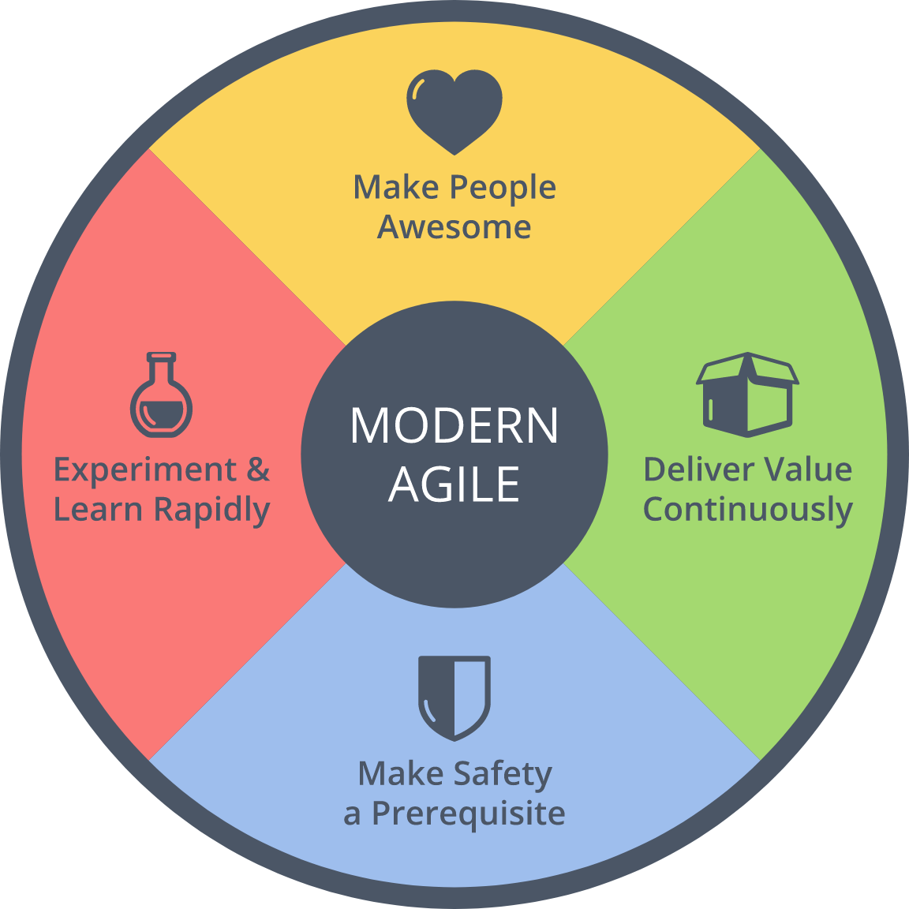
$ history
6 times attendee from Japan!
2014 : Speaker
Brought back Metrics
2016 : Brought back

Slide 4

What is Agile2018?
https://www.agilealliance.org/agile2018/
Annual global conference of Agile in USA
The biggest one of Agile
Held by Agile Alliance

Slide 5
Basic Information
Duration | 8/6 (Mon) - 8/10 (Fri)
# of sessions | 279 (+5 YoY)
# of categories | 21 (±0 YOY)
# of parallel on-going sessions | 20 (+1 YoY)
# of attendees | 2,500
2 Types : Talk/Workshop
3 Levels : Learning/Practicing/Advancing

Slide 6
Categories (2018)
Category | # | Category | #
Agile Companies | 16 | Keynotes | 3
Agile Data Metrics and Forecasting | 6 | Leadership | 21
Agile Foundations | 7 | Learning | 19
Agile Midway | 7 | Project Program & Portfolio Management | 18
Coaching & Mentoring | 21 | Testing & Quality | 12
Collaboration Culture & Teams | 24 | User Experience | 12
Customers & Products | 15 | Experience Reports | 24
Dev Practices and Craft | 17 | The Future of Agile Software Development (IEEE Software) | 8
DevOps | 12 | Audacious Salon | 14
Enterprise Agile | 20 | Stalwarts | 10

Slide 7
Categories (2018)
Category | # | Category | #
Agile Companies | 16 | Keynotes | 3
Agile Data Metrics and Forecasting | 6 | Leadership | 21
Agile Foundations | 7 | Learning | 19
Agile Midway | 7 | Project Program & Portfolio Management | 18
Coaching & Mentoring | 21 | Testing & Quality | 12
Collaboration Culture & Teams | 24 | User Experience | 12
Customers & Products | 15 | Experience Reports | 24
Dev Practices and Craft | 17 | The Future of Agile Software Development (IEEE Software) | 8
DevOps | 12 | Audacious Salon | 14
Enterprise Agile | 20 | Stalwarts | 10
Promoted as one category!

Slide 8
[FYI] Categories (2017)
Category | # | Category | #
Agile Alliance Lounge | 16 | Leadership | 21
Agile Companies | 13 | Learning | 17
Agile Foundations | 7 | Project Program & Portfolio Management | 21
Coaching & Mentoring | 17 | Testing & Quality | 12
Collaboration Culture & Teams | 24 | User Experience | 10
Customers & Products | 15 | Experience Reports | 24
Development Practices & Craftsmanship | 24 | The Future of Agile Software Development (IEEE Software) | 8
DevOps | 16 | Audacious Salon | 14
Enterprise Agile | 25 | Open Jam | 6
Keynotes | 3 | Stalwarts | 11

Slide 9
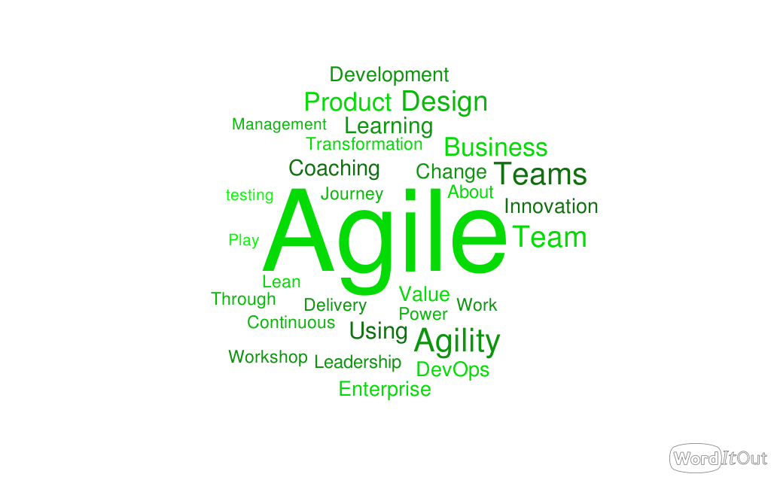
Trends of Agile2018

Slide 10
Trends of Agile2018
Agile @ scale
Business Agility
DevOps for ???

Slide 11
My Motivation
Need to LINE Corp.
Engineering
Scaling Agile
Testing

Slide 12
Agenda
1. Scaling Agile
2. Business Agility
3. Technologies for Trial & Errors
4. Other Topics
5. Conclusion

Slide 13
1. Scaling Agile
2. Business Agility
3. Technologies for Trial & Errors
4. Other Topics
5. Conclusion

Slide 14
Summary
Beyond IT
Utilize Agile to corporate level
Need to overcome silos

Slide 15
1. Scaling Agile
2. Business Agility
3. Technologies for Trial & Errors
4. Other Topics
5. Conclusion

Slide 16



解決方針
何らかの （動作する）成果物を 毎週作成・提示する

Slide 17
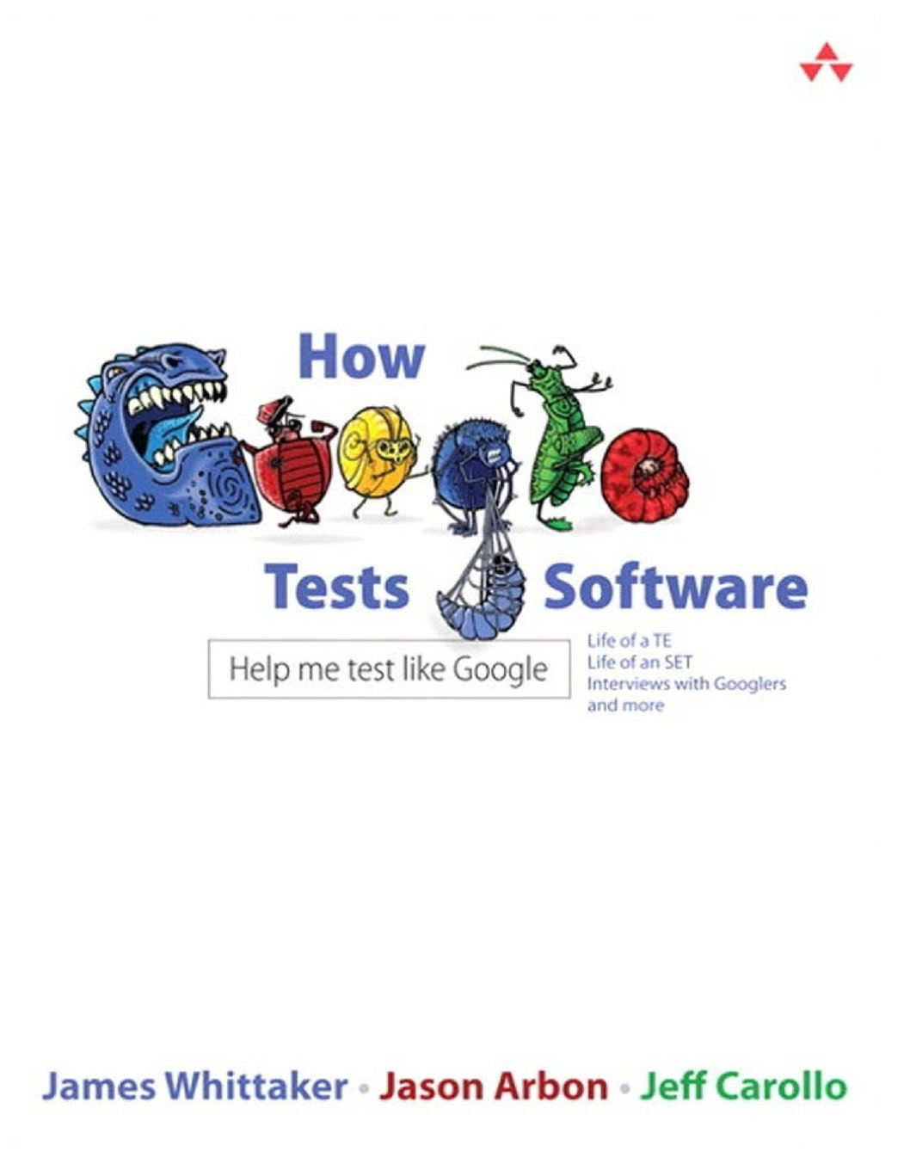
Making Impacts Constantly
“Managing impact for a team of TEs and SETs is the job of the TEM.”
from How Google Tests Software

Slide 18
1. Scaling Agile
2. Business Agility
3. Technologies for Trial & Errors
4. Other Topics
5. Conclusion

Slide 19
Learning to Experiment
aaa

Slide 20
Database DevOps
aaa

Slide 21
Radical Change for Testers
aaa

Slide 22

解決方針
自動テストを活用した
プロダクトの仕様・設計の把握
※画像はイメージです

Slide 23
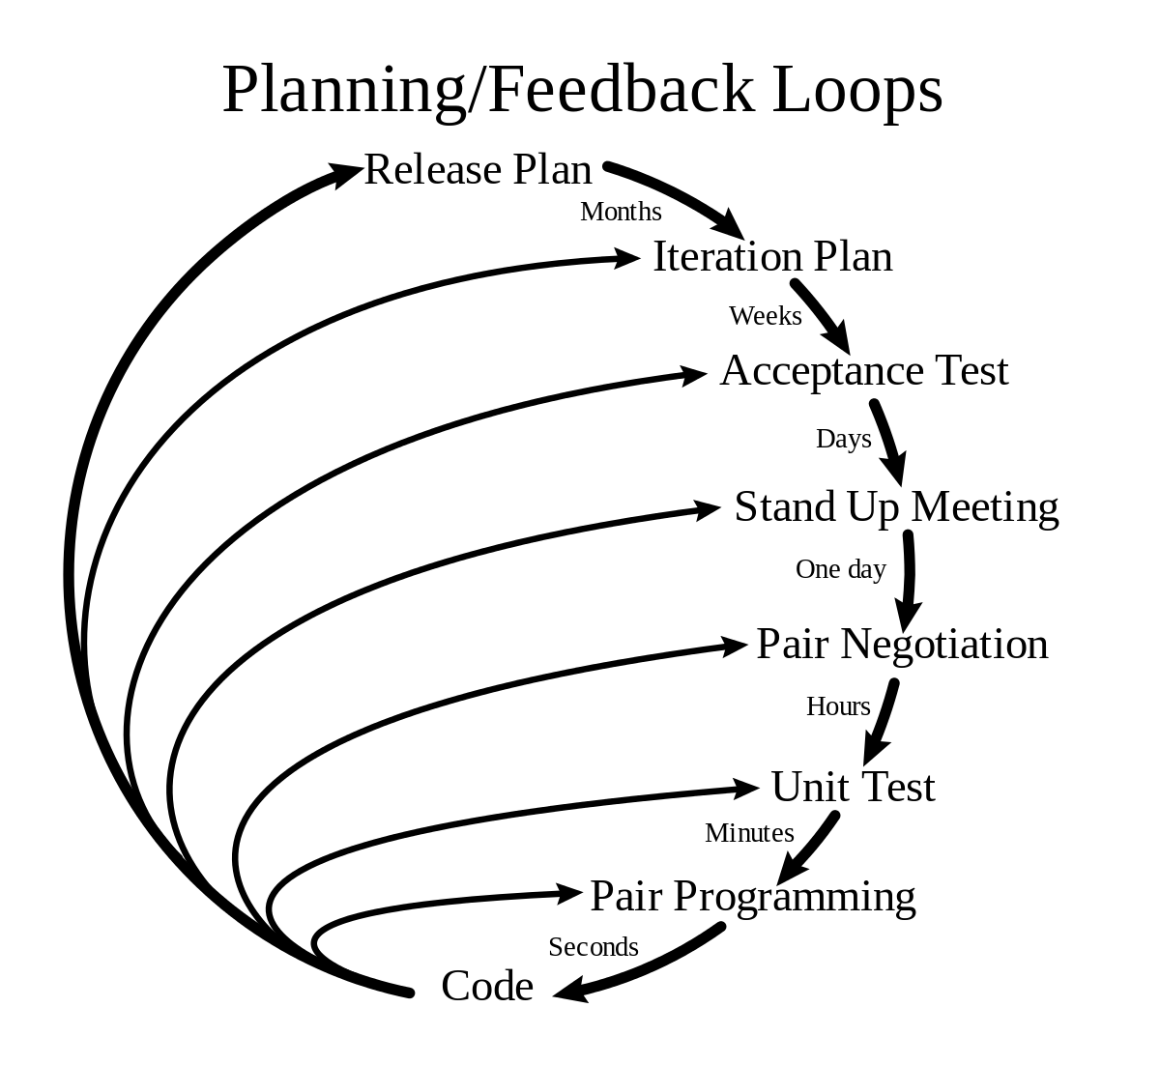
アジャイルの要素
XPを活用した
高速な学習の仕組みの構築と活用

Slide 24
自動テスト＝心理的安全性
（参考）Modern Agile
ここ！

Slide 25
1. Scaling Agile
2. Business Agility
3. Technologies for Trial & Errors
4. Other Topics
5. Conclusion

Slide 26
Testing
お手軽障害検知システムの構築
Spring BootでAPIを呼び出し、 その結果をJUnitで検証する （開発者に後日作り込んでもらうため）
Jenkinsで2分に1回のペースで実行
テストが失敗したら関係者にメール通知
開発チームのMTTR向上が当初の狙い

Slide 27
1. Scaling Agile
2. Business Agility
3. Technologies for Trial & Errors
4. Other Topics
5. Conclusion

Slide 28
これ
1. Moving toward business clearly
Development -> QA/PDM -> Company-wide
2. Utilize technologies for
outcome/value
tools for trial & error
3. Scaling?

Slide 29
Summary
Technology
+
Process
=
Improve Business

